Slide 1
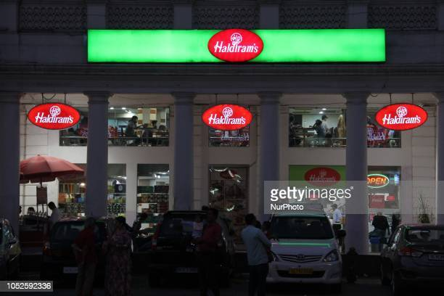
PROJECT – 1 MBA671A SERVICE INDUSTRY AND PROBLEMS HALDIRAMS
NAME:- ANTRIKSH DOGRA
ROLL NO.:-200160
DEPT.:- AEROSPACE

Slide 2
TABLE
BACKGROUND
INTRODUCTION
PROBLEM DESCRIPTION
CURRENT PRACTISE
FUTURE RECOMMEDATION

Slide 3
BACKGROUND
Service industries are the ones that provide people with intangible products or services and completes tasks that are asked by or useful to customers, clients, or the general public. We are discussing about the services that are provided by a services industry like in restaurants, salons, hospitals, hotels, etc. when a customer visits in these service industries.

Slide 4
INTRODUCTION
In this presentation we are going to analysis the services facilities and hospitality that is provided by haldrim’s restaurants outlet in connaught place, Delhi. We will analysis the various problem that are present and find out the ways how we can deal with it in short time period and also finding the solution in long term period.

Slide 5
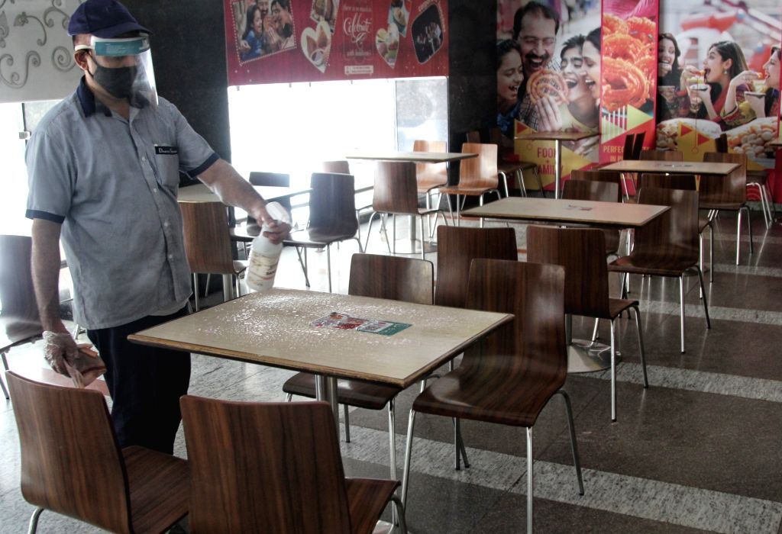
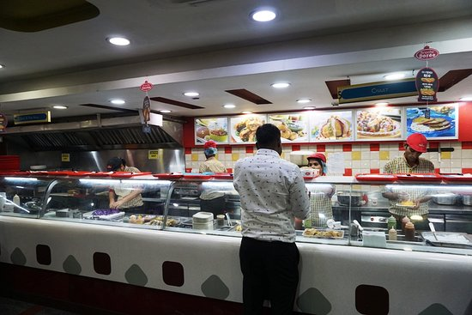
HALDIRAM’S CONNAUGHT PLACE OUTLET IMAGES

Slide 6
PROBLEM DESCRIPTION
Space crunch : The seating capacity available there was present was not sufficient compared to the customers present and was congested. And spacing between the tables is also very less.
Time consuming/ Long waiting: Although there are different counters for all the dishes that are served but few items that are best sellers for example choley bhature, etc there is a long waiting for it.

Slide 7
Not proper Ventilation / suffocation: Due to large crowd in the small sitting place there is suffocation.
No waiters: There are no waiters available to take order in this case for aged people its tough to stand in queue for billing and then after that for orders.
Cleaning of tables : After the customer leaves the table is not cleaned immediately have to wait for them to come and clean or have to ask for it.

Slide 8
Online ordering system not working : Although QR codes are present on each table but one cannot order using those because its not in use.

Slide 9
CURRENT PRACTISE
Billing counter: There are only 2 billing counters present in haldiram’s.
Food serving: There is self service in haldiram’s. one have to take token and then visit the counter of that item and show token and wait for their order to come.
Sitting Area: there are 2 floors ground and 1st floor. On ground floor there is sitting as well and standing space available and on 1st floor there is only sitting place available.

Slide 10
Food Counters: For all the food dishes there are different counters like separate section for sweets, for chaats, choley bhature, packed items(like namkeens, etc),haldiram’s veg thali, etc.
No provision for aged people and ladies:- There is no specials services provided to the aged people and ladies that is an staff attendant or waiters to take their orders and also no special sitting place for them.
Transparent food preparing counters: The food items are made in front of the customer using pre prepared food items.

Slide 11
FUTURE RECOMMEDATION
Extension of outlet: To solve the spacing and sitting area related problems, there can be extension by purchasing the land or by increasing more standing tables as it consumes less space compared to the sitting once.
Multiple counters for same dish/ food items: As from the data it can be analysed that these are best seller and often order for such food items there can be multiple counters to manage the crowd properly and this will decrease the waiting time.

Slide 12
Online ordering system: it should be brought into working condition. This will ease the services more over people no longer have to be in the queue.
Increase Labour : Work force should be increase by recruiting more people for post of waiters, staff attendant, etc. This solve problems faced by aged people while ordering.
Ventilation: To solve ventilation problem the centrally fitted AC should be checked and are working properly and exhausts should also be used.

Slide 13
THANK YOU

